Slide 1
Machine Learning Overview
Edward Wang, Ph.D.

Slide 2
Data Analytics for Manufacturing
What happened?
Why exactly?
What will happen?
What is the plan?
Descriptive
Historical analysis to establish statistical benchmarks for updating knowledge base
Statistical measures Regression Correlation analysis Principal component analysis Visualization
Diagnostic
Identification of root causes and key factors to facilitate decision making
Time-frequency analysis Bayesian inference K-means clustering Support vector machine Neural network
Prognostic
Discovery and analysis of system variation pattern & quantification of uncertainties
Decision trees Wiener process Support vector regression Neural network Kalman filter Particle filter
Prescriptive
Action scheduling and process optimization for improved KPIs
Sensitivity analysis Reliability analysis Local and global optimization Linear and nonlinear programing

Slide 3


Classification of Process Monitoring Issues
Slurry
Type
Abrasive size
pH Value
Abrasive hardness
Concentration
Flow rate
Additive
Zeta potential
Others
Temperature
Polishing time
Dresser
Conditioning motion
Abrasive type
Abrasive density
Abrasive configuration
MRR [nm/min]
Wafer
Pressure
Pattern hardness
Film type
Wafer size
Pad
Hardness
Compressibility
Relative speed
Worn degree

Slide 4
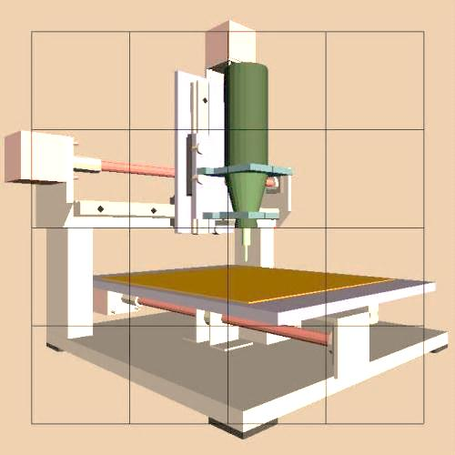
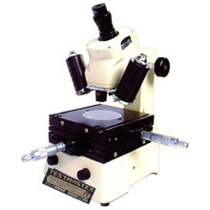
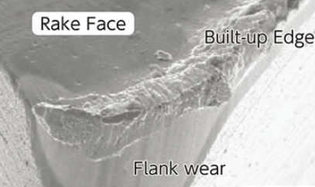
Classification of Process Monitoring Issues
Online Measurement
Offline Measurement
Machine Structure
Vibration
AE
Spindle Motor
Current/power
Speed
Position
Force/Torque
Microscope
Cutting Process
AE
Vibration
Dynamometer
Cutting force
Axis Drive
Current/power
Velocity
Position
Ball Screw
Force
From sensing data to system performance
From sensing data variation pattern to system performance degradation pattern

Slide 5
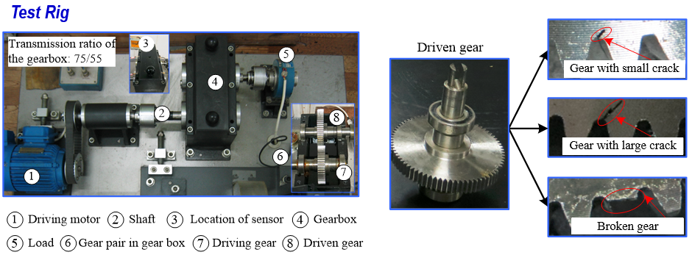
Classification of Process Monitoring Issues
Artificially made 4 fault severity levels
Operation Condition | Rotational speed: 1,800 RPM
Measurement | Four sensors Sampling frequency: 8192 Hz
Level #1
#2
#3
#4
Level #1
Normal
Small
crack
Large crack
Broken gear

Slide 6
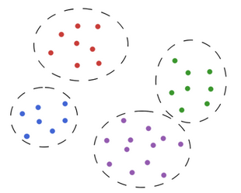
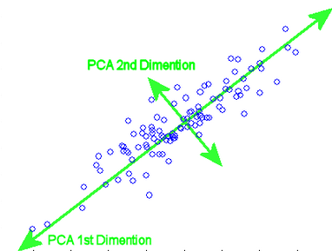
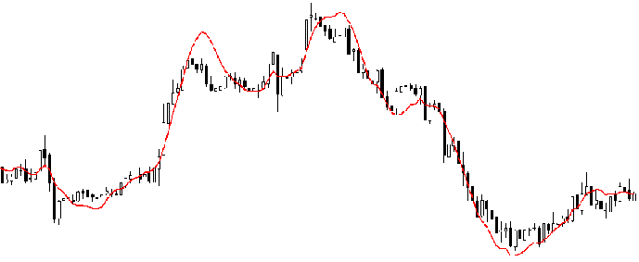

Machine Learning Techniques
Yes
Hierarchical clustering
Learn similarities and differences among data
Clustering
Hierarchical?
Gaussian mixture model
Yes
No
Probabilistic?
Unsupervised Learning
No
K-means
Yes
Principal component analysis
Dimensionality Reduction
Topic model?
Singular value decomposition
Yes
Machine Learning
No
Probabilistic?
No
Latent dirichlet allocation
Regression
Linear regression
Logistic regression
Thin plate Spline
Decision tree
Naive Bayes
Linear SVM
Random forest
Neural network (Deep Learning)
Kernel SVM
Gradient boosting tree
Supervised Learning
Speed
Accuracy
Discover the relationship between inputs to human-labeled outputs
Classification

Slide 7
Machine Learning Techniques: Comparison
Supervised ML: Discover the relationship between system inputs (e.g. process parameters) and outputs (e.g. part quality)
Technique | Expression | Accuracy | Speed | Automatic feature learning | Performance on small dataset | Handling with non-linearity | Parameter to be tuned
Linear regression |  | Low | Fast | No | Good | Poor | None
Logistic regression |  | Low | Fast | No | Good | Poor | None
Naive Bayes |  | Low | Fast | No | Good | Poor | Some
Linear SVM |  | Low | Fast | Yes | Good | Poor | Some
Thin plate splines |  | High | Fast | No | Good | Good | Some
Kernel SVM |  | High | Slow | Yes | Good | Good | Some
Random forest |  | High | Slow | Yes | Poor | Good | Some
Boosting tree |  | High | Slow | Yes | Poor | Good | Some
Neural Network |  | High | Slow | Yes | poor | Good | Many
B: number of trees

Slide 8
Questions to Answer Before Building a ML Model
What question(s) am I trying to answer? Do I think the data collected can answer that question?
What is the best way to phrase my question(s) as a machine learning problem?
Have I collected enough data to represent the problem I want to solve?
What features of the data did I extract, and will these enable the right predictions?
How will I measure success in my application?
How will the machine learning solution interact with other parts of my research or business product?

